Slide 1
ENGINEERING GRAPHICS
UNIT- 2
Topic:
Projection of Points

Slide 2

ORTHOGRAPHIC PROJECTIONS:
IT IS A TECHNICAL DRAWING IN WHICH DIFFERENT VIEWS OF AN OBJECT ARE PROJECTED ON DIFFERENT REFERENCE PLANES
OBSERVING PERPENDICULAR TO RESPECTIVE REFERENCE PLANE
Different Reference planes are
Horizontal Plane (HP),
Vertical Frontal Plane (VP)
Side Or Profile Plane (PP)
And
Different Views are Front View (FV), Top View (TV) and Side View (SV)
FV is a view projected on VP
TV is a view projected on HP
SV is a view projected on PP
IMPORTANT TERMS OF ORTHOGRAPHIC PROJECTIONS:
1
Planes.
Pattern of planes & Pattern of views
Methods of drawing Orthographic Projections
2
3

Slide 3




PLANES
PRINCIPAL PLANES
HP AND VP
AUXILIARY PLANES
Auxiliary Vertical Plane
(A.V.P.)
Auxiliary Inclined Plane
(A.I.P.)
Profile Plane
( P.P.)

A.V.P.
A.I.P.
⊥ to Hp & ∠ to Vp
⊥ to Vp
&
∠ to Hp


Slide 4
PATTERN OF PLANES & VIEWS (First Angle Method)
THIS IS A PICTORIAL SET-UP OF ALL THREE PLANES.
ARROW DIRECTION IS A NORMAL WAY OF OBSERVING THE OBJECT.
BUT IN THIS DIRECTION ONLY VP AND A VIEW ON IT (FV) CAN BE SEEN.
THE OTHER PLANES AND VIEWS ON THOSE CAN NOT BE SEEN.
Y
PROCEDURE TO SOLVE ABOVE PROBLEM:-
TO MAKE THOSE PLANES ALSO VISIBLE FROM THE ARROW DIRECTION,
A) HP IS ROTATED 90⁰ DOUNWARD
B) PP, 90⁰ IN RIGHT SIDE DIRECTION.
THIS WAY BOTH PLANES ARE BROUGHT IN THE SAME PLANE CONTAINING VP.
X
Y
VP
PP
FV
LSV
X
Y
X
TV
HP
ACTUAL PATTERN OF PLANES & VIEWS
OF ORTHOGRAPHIC PROJECTIONS
DRAWN IN
FIRST ANGLE METHOD OF PROJECTIONS
HP IS ROTATED DOWNWARD 90⁰
AND
BROUGHT IN THE PLANE OF VP.
PP IS ROTATED IN RIGHT SIDE 90⁰
AND
BROUGHT IN THE PLANE OF VP.

Slide 5
Projection of Points
A “Point” may be situated, in space, in any one of the “four quadrants” formed by the “two reference/ principal planes” or a point may lie in any one or both of them,
The projections of a “Point” are obtained by extending projectors perpendicular to the reference/ principal planes,
One of the reference/ principal planes is then rotated so that the first and third quadrants are opened out,
The projections of point are shown on a flat surface in their respective positions either above or below or in xy line.

Slide 6
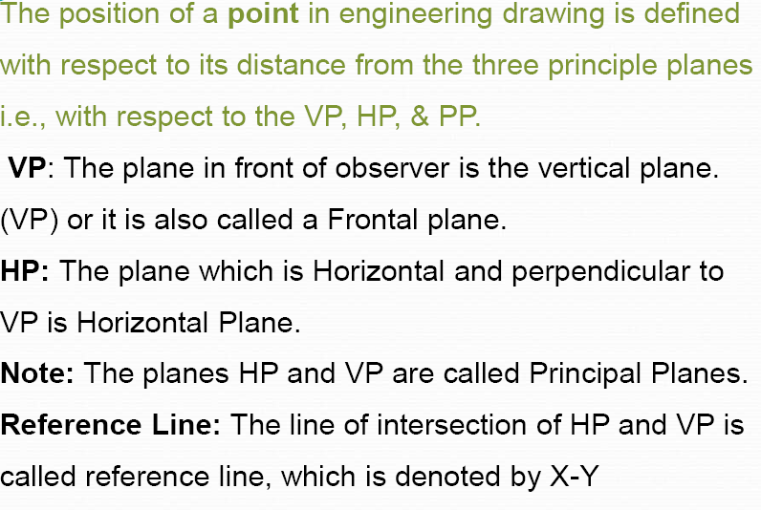
Projection of Points

Slide 7
PROJECTIONS OF POINTS
TO DRAW PROJECTIONS OF ANY OBJECT (Eg. POINT),
ONE MUST HAVE FOLLOWING INFORMATION
A) OBJECT (POINT)
{ WITH IT’S DESCRIPTION, WELL DEFINED}
B) OBSERVER
{ ALWAYS OBSERVING PERPENDICULAR TO RESP. REF. PLANE}
C) LOCATION OF OBJECT
{ MEANS IT’S POSITION WITH REFFERENCE TO H.P. & V.P.}
TERMS ‘ABOVE’ & ‘BELOW’ WITH RESPECTIVE TO H.P.
AND TERMS ‘INFRONT’ & ‘BEHIND’ WITH RESPECTIVE TO V.P
FORM 4 QUADRANTS.
OBJECTS CAN BE PLACED IN ANY ONE OF THESE 4 QUADRANTS.
IT IS INTERESTING TO LEARN THE EFFECT ON THE POSITIONS OF VIEWS ( FV, TV )
OF THE OBJECT WITH RESP. TO X-Y LINE, WHEN PLACED IN DIFFERENT QUADRANTS.
TO MAKE IT EASY, HERE A POINT A IS TAKEN AS AN OBJECT. BECAUSE IT’S ALL VIEWS ARE
JUST POINTS.

Slide 8
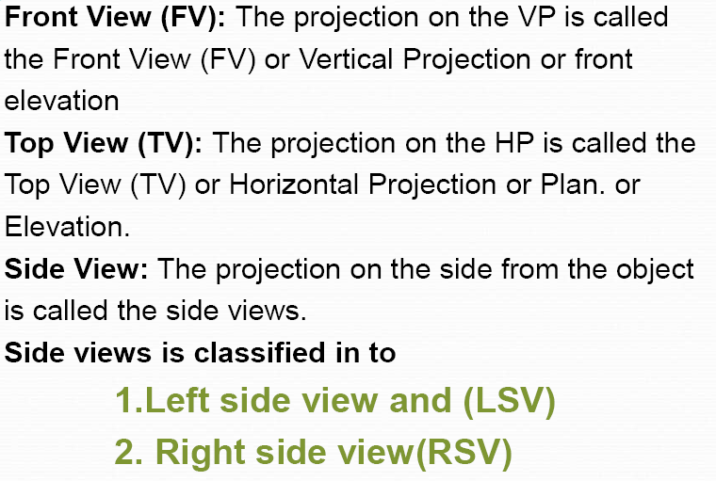
Types of Views

Slide 9
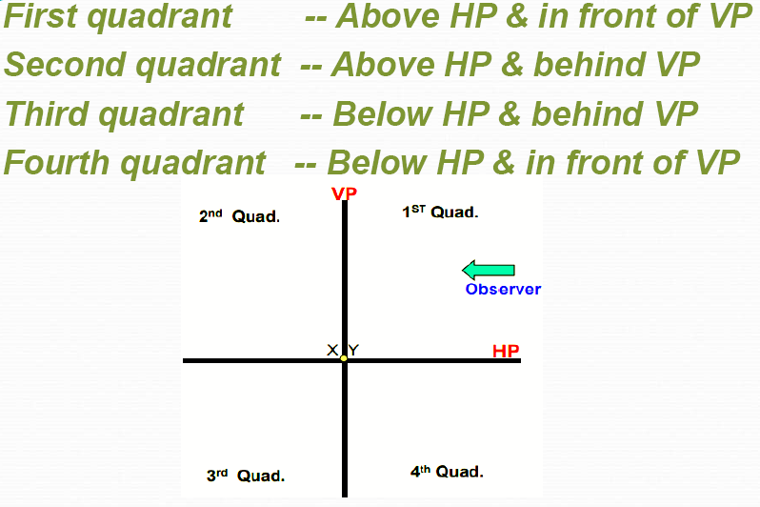
Positions of Points

Slide 10
NOTATIONS
FOLLOWING NOTATIONS SHOULD BE FOLLOWED WHILE NAMEING
DIFFERENT VIEWS IN ORTHOGRAPHIC PROJECTIONS.
OBJECT POINT A LINE AB
IT’S TOP VIEW a a b
IT’S FRONT VIEW a’ a’ b’
IT’S SIDE VIEW a” a” b”
SAME SYSTEM OF NOTATIONS SHOULD BE FOLLOWED
INCASE NUMBERS, LIKE 1, 2, 3 – ARE USED.

Slide 11

2nd Quadrant
VP
2nd Quad.
1ST Quad.
F.V.
1st Quadrant
Y
Observer
X Y
HP
X
3rdQuadrant
Observer
3rd Quad.
4th Quad.
4th Quadrant
THIS QUADRANT PATTERN,
IF OBSERVED ALONG X-Y LINE ( IN RED ARROW DIRECTION)
WILL EXACTLY APPEAR AS SHOWN ON RIGHT SIDE AND HENCE,
IT IS FURTHER USED TO UNDERSTAND ILLUSTRATION PROPERLLY.

Slide 12
Point A is
Placed In
different
quadrants
and it’s Fv & Tv
are brought in
same plane for
Observer to see
clearly.
Fv is visible as
it is a view on
VP. But as Tv is
is a view on Hp,
it is rotated
downward 90⁰,
In clockwise
direction.The
In front part of
Hp comes below
xy line and the
part behind Vp
comes above.
Observe and
note the
process.
POINT A IN
2ND QUADRANT
VP
POINT A IN
1ST QUADRANT
VP
a’
A
A
a’
a
HP
OBSERVER
HP
OBSERVER
a
a
HP
HP
OBSERVER
OBSERVER
a
a’
A
a’
POINT A IN
3RD QUADRANT
A
POINT A IN
4TH QUADRANT
VP
VP

Slide 13
PROJECTIONS OF A POINT IN FIRST QUADRANT.
POINT A ABOVE HP
& INFRONT OF VP
POINT A ABOVE HP
& IN VP
POINT A IN HP
& INFRONT OF VP
For Tv
For Tv
PICTORIAL
PRESENTATION
PICTORIAL
PRESENTATION
For Tv
a’
a’
A
A
For Fv
Y
Y
Y
For Fv
a
a’
X
a
a
X
X
A
For Fv
ORTHOGRAPHIC PRESENTATIONS
OF ALL ABOVE CASES.
Fv above xy,
Tv below xy.
Fv above xy,
Tv on xy.
Fv on xy,
Tv below xy.
VP
VP
VP
a’
a’
X
Y
X
Y
X
a’
Y
a
a
a
HP
HP
HP

Slide 14
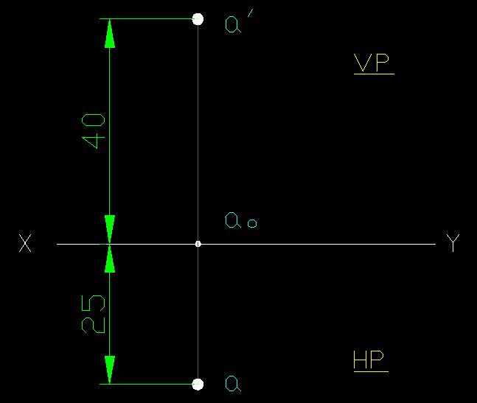
CASE 1: Point A is 40 mm above HP & 25 mm infront of VP. Draw Projections.

Slide 15
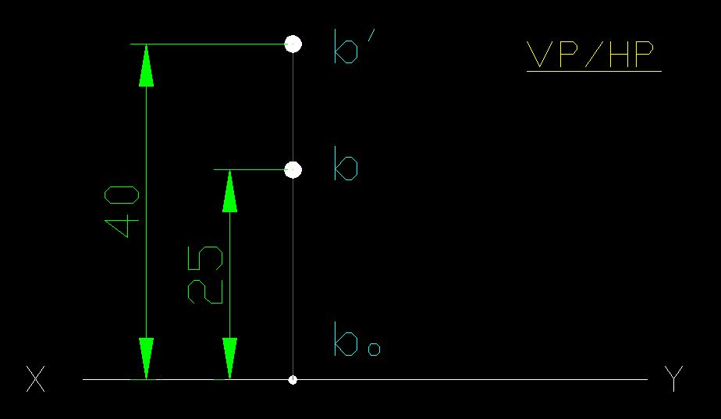
CASE 2: Point B is 40 mm above HP & 25 mm behind VP. Draw Projections.

Slide 16
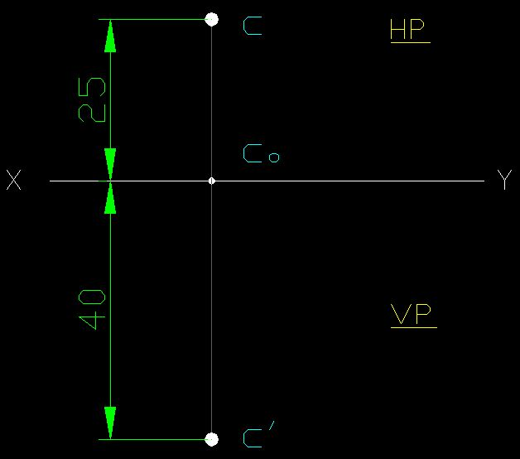
CASE 3: Point C is 40 mm below HP & 25 mm behind VP. Draw Projections.

Slide 17
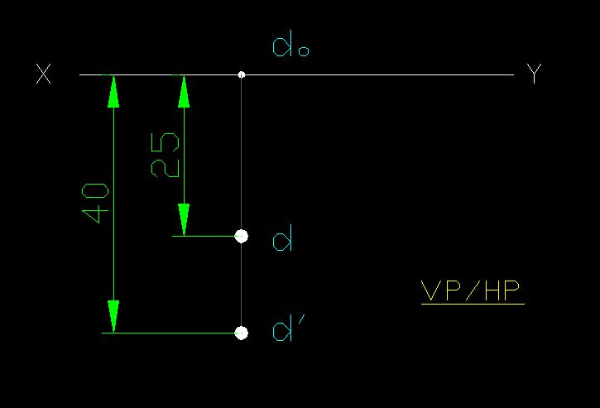
CASE 4: Point D is 40 mm below HP & 25 mm infront of VP. Draw Projections.

Slide 18
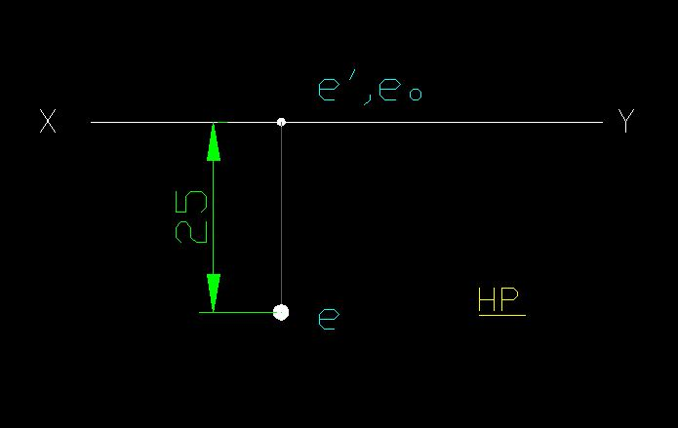
CASE 5: Point E is in HP & 25 mm infront of VP. Draw Projections.

Slide 19
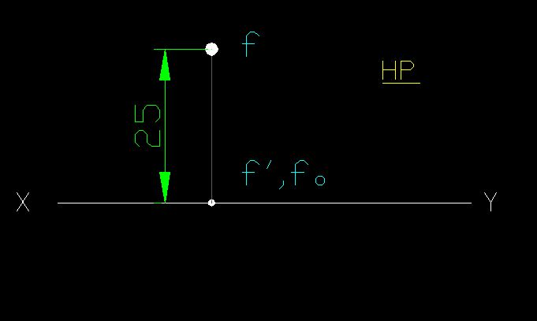
CASE 6: Point F is in HP & 25 mm behind VP. Draw Projections.

Slide 20
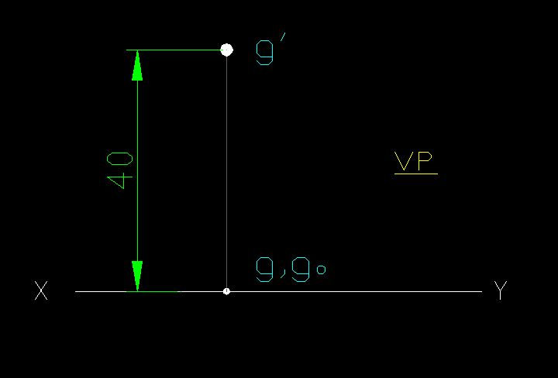
CASE 7: Point G is 40 mm above HP & in VP. Draw Projections.

Slide 21
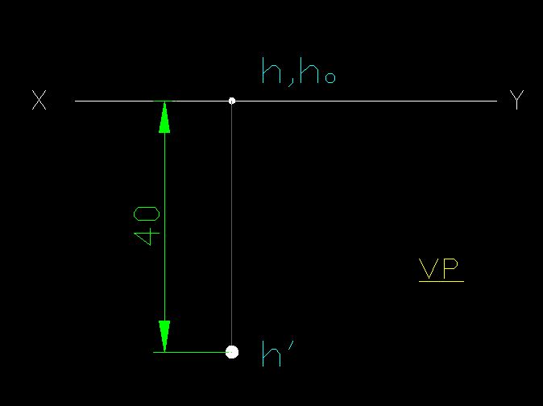
CASE 8: Point H is 40 mm below HP & in VP. Draw Projections.

Slide 22
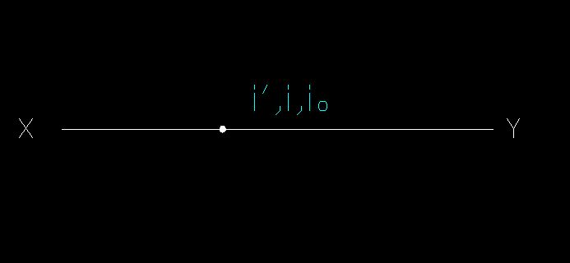
CASE 9: Point I is in HP & in VP. Draw Projections.

Slide 23
THANKS

Slide 24
MEC103 TUTORIAL

Slide 28
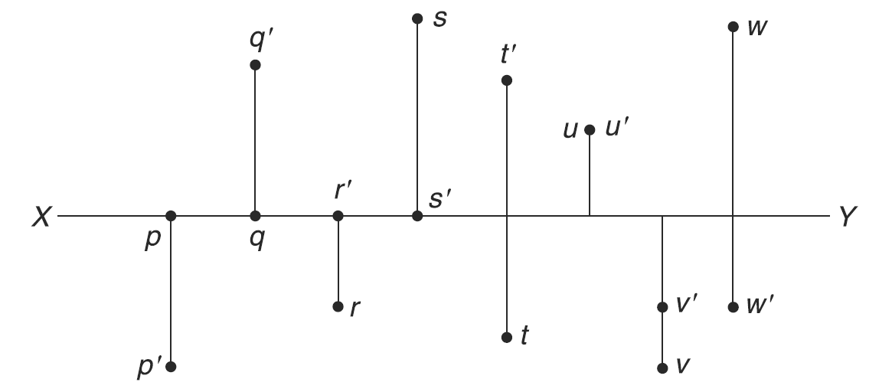
Identify the positions of the points shown in Fig.

Slide 29
A point P is 50 mm from both the reference planes. Draw its projections in all possible positions.

Slide 31
Draw the projections of the following points:
Point M (+55 mm, –35 mm), Point N (–35 mm, +55 mm), Point O (–55mm, +35 mm), Point P (+35 mm, –55 mm), Point Q (+55 mm, 0), Point R (–35 mm, 0), Point S (0, +35 mm), and Point T (0, –55 mm)

